Slide 1
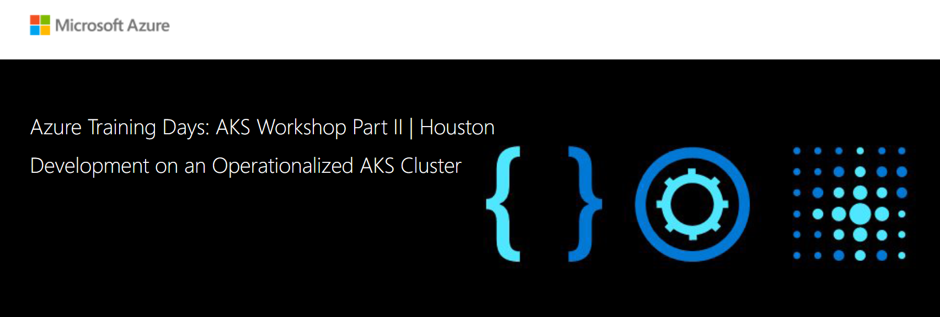
Azure Dev Spaces

Slide 2

Azure Kubernetes Service Cluster
V2
Front End WebApp
Redis Service
Backend API
Database
Result WebApp

Slide 3
Azure Dev Spaces
Your isolated playground in an AKS cluster.
Provides a rapid and iterative Kubernetes development experience for teams in an AKS cluster.
Allows debugging and testing of all components with minimal set up on the local machines.
Removes the need to replicate or mock up dependencies.
Decreases setup time for new developers on the team.

Slide 4
Azure Dev Spaces

Slide 5

Azure Dev Space Approach
Light yellow
Iterate Fast, directly to Azure
Yellow (Primary brand color)
Light blue
Red (Primary accent color)
Blue (Primary brand color)
AKS with Dev Spaces
Dark red
Mid blue
Edit content (html, css, cshtml)
Update file directly in running container
Light orange
Dark blue
Edit server code
Restart node service, .NET build/run
Orange (Primary brand color)
Edit Dockerfile, Helm chart...
Rebuild container image, redeploy

Slide 6
Demo: Azure Dev Space

Slide 7
Resources
Dev Spaces Documentation: https://docs.microsoft.com/en-us/azure/dev-spaces/
Quick Start: https://docs.microsoft.com/en-us/azure/dev-spaces/quickstart-team-development
Sample Bike Sharing App: https://github.com/Azure/dev-spaces/tree/master/samples/BikeSharingApp

Slide 8
Thank You

